Slide 1
A Brief Overview of ASME Y14 Engineering Product Definition and Related Documentation Practices
By Fredric Constantino

Slide 2
ASME Y14 Engineering Product Definition and Related Documentation Practices
In 1957 the first edition of Y14.5 American Drafting Standards Manual, Section 5, Dimensioning and Notes, was published; A revision of Z14.1-1946 sections 5, 6 and 7.
In the 1970’s the committee worked to prepare voluntary consensus standards to replace military standards where government practices were found to be common with the industry at large. Some examples are:
    Chapter 700 of military standard, MIL-STD-100, was used as the basis for the Y14.34M standard; Chapter 200 of MIL-STD-100 was used as the basis for the Y14.24M standard; and Chapter 600 of the MIL-STD-100 was used as the basis for Y14.35M standard.
The Y14 committee continues to work closely with the Department of Defence (DoD) to ensure that the needs of the federal agency and industry are fulfilled through the voluntary consensus process.

Slide 3
ASME Y14 Engineering Product Definition and Related Documentation Practices
Charter:
The development and maintenance of national standards for defining and documenting a product throughout its life cycle and related certification activities. This shall be accomplished by:
  Recognizing the continuing need for existing standards regardless of the source medium (e.g., paper, film, and digital) or method of preparation (e.g., manual or computer generated);
  Providing standardization where a variety of practices exist within industry and government;
  Providing standards for new concepts and technologies; and
  Supporting and coordinating development and harmonizing of standards with responsible standardization bodies, including ANSI, ISO, and government agencies.

Slide 4
ASME Y14 Engineering Product Definition and Related Documentation Practices
Home to 28 active subcommittees
Upholds 23 published standards
Maintains 1 GD&T Certification Exam
Holds the U.S. TAG to ISO TC 10 on Technical Product Documentation
Part of the U.S. TAG to ISO TC 213 on Dimensional and Geometrical Product Specifications and Verification

Slide 5
ASME Y14 Engineering Product Definition and Related Documentation Practices
The Y14 series provides comprehensive criteria for implementing GD&T effectively across the manufacturing supply chain:
  Geometric Dimensioning & Tolerancing (GD&T) – 3 standards (Y14.5, Y14.5.1, Y14.41)
  Drafting Practices – 11 standards (e.g., Orthographic and Pictorial Views, Drawing Sheet Size and Format)
  Mechanism and Devices – 5 standards (e.g., Screw Thread Representation, Mechanical Spring Representation, Gears)
  Symbols & Abbreviations– 5 standards ( e.g. Y14.36 Surface Texture Symbols, Y14.38 Abbreviations, Y32.7 and Y32.18 Graphic and Diagram Symbols)
  Certification – 1 GD&T Certification Exam (Y14.5.2)

Slide 6
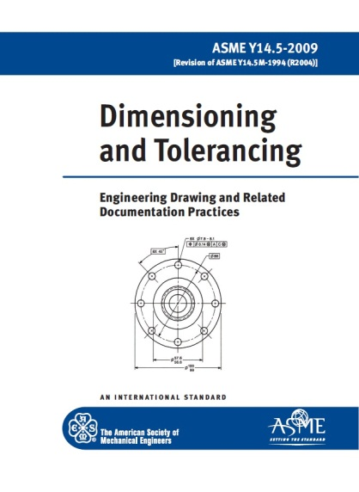
ASME Y14 Engineering Product Definition and Related Documentation Practices
Y14.5 – 2009 Dimensioning and Tolerancing
Considered the authoritative guideline for the design language of Geometric Dimensioning and Tolerancing GD&T
Essential for communicating design intent – Ensure parts from technical documents have the desired form, fit, function and interchangeability
Establishes uniform practices – stating and interpreting GD&T and related requirements
Provides numerous examples
Revision currently in progress
  www.asme.org/shop/standards

Slide 7
ASME Y14 Engineering Product Definition and Related Documentation Practices
Y14.5 – 2009 Dimensioning and Tolerancing
The six most important changes in this revision are:
Explanation of datum references in terms of degrees of freedom
Allowing customization of the degrees of freedom constrained by datum feature references
Expanding composite position tolerance explanations to include three segments
Simplification of the explanation of composite tolerances
Clarification of surface boundaries taking precedence over axis methods of interpretation
Expansion of the explanation of profile tolerances
  www.asme.org/shop/standards

Slide 8
ASME Y14 Engineering Product Definition and Related Documentation Practices
Y14.5 – 2009 Dimensioning and Tolerancing
Benefits of Y14.5-2009 verses ISO GD&T standards:
Complete set of GD&T requirements in one concise standard that uses consistent terminology and concepts
One volume verses a wide bookshelf of volumes being revised at different times
Real-world standard written for the practitioner (opposed to high-level standards written for the theorist)
Provides numerous examples of how GD&T application
  www.asme.org/shop/standards

Slide 9
ASME Y14 Engineering Product Definition and Related Documentation Practices

Slide 10
ASME Y14 Engineering Product Definition and Related Documentation Practices
GD&T Training and Certification
Y14 member lead ASME GD&T training courses and certifications classes
Geometric Dimensioning & Tolerancing Fundamentals 1
  (Short Course) … in-depth study designed to develop a basic working knowledge in GD&T.
  ASME Course No.: PD570; CEU’s: 1.50; PDH’s: 15.00; No. Days: 2
Geometric Tolerancing Applications and Tolerance Stacks
  (Short Course) … in-depth study of how to apply GD&T and perform tolerance stacks using case study problems including sheet metal, machining, plastic parts, castings, etc..
  ASME Course No.: PD561; CEU’s: 1.50; PDH’s: 15.00; No. Days: 2
Basic Geometric Dimensioning & Tolerancing (GD&T) Y14.5
  (Online Instructor-led Course) … covers most of the geometric dimensioning controls used on mechanical engineering drawings. Also covers areas of design, tooling, production, and inspection.
  ASME Course No.: ZI010; CEU’s: 2.30; No. Days: 43
Advanced Geometric Dimensioning & Tolerancing (GD&T) Y14.5
  (Online Instructor-led Course)… develop Advanced GD&T competencies.
  ASME Course No.: ZI100; CEU’s: 2.30; No. Days: 43
  www.asme.org/shop/courses

Slide 11
ASME Y14 Engineering Product Definition and Related Documentation Practices
GDTP(Y14.5) - Geometric Dimensioning and Tolerancing Professional Certification
  ASME GDTP Certification provides the means to recognize proficiency in the understanding and application of the geometric dimensioning and tolerancing (GD&T) principles expressed in the ASME Y14.5 Standard.
  Based on a multiple-choice examination.
  Intended for Design Engineer; CAD/CAM/CAE Specialist; Drafter, Production or Manufacturing Engineer; Process Engineer; Quality Engineer; Tool or Gage Engineer; Engineering Manager; Checker; Engineering Consultant; Educator; Inspector; Contract Engineer; Project Engineer; and Technical Specialist.
  www.asme.org/shop/certification-accreditation

Slide 12
ASME Y14 Engineering Product Definition and Related Documentation Practices
For additional information, including future meetings and document updates. Go to:
go.asme.org/Y14committee

Slide 13
ASME Y14 Engineering Product Definition and Related Documentation Practices
QUESTIONS??

